Slide 1
Analysis of International COVID-19 Vaccine Tweets
Team Members:
Pooja M. Desai, Tong Shen, Lucas Lu, Cong Zhang
Final Project Presentation
Natural Language Processing
Fall 2021
Notes:
Pooja

Slide 2
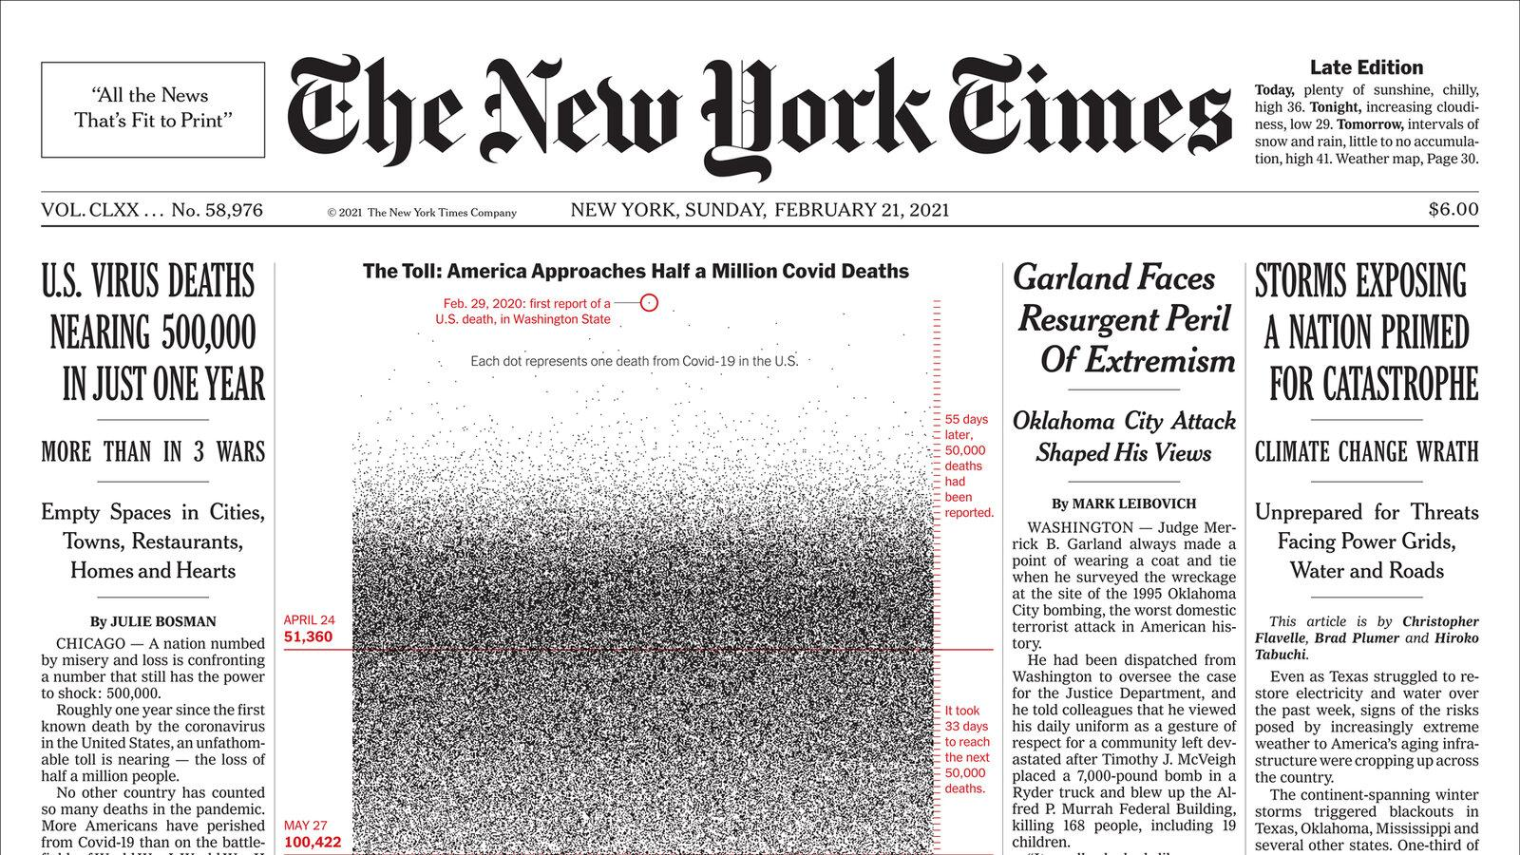
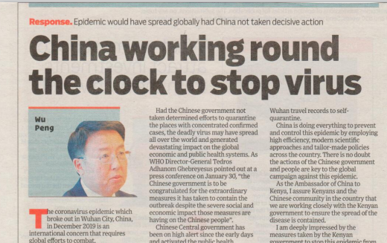


Background
Notes:
Pooja: Since Covid-19 has last almost two years, the impact of the Covid-19 is still serious to our daily lives. Twitter is a media reflects how the ordinary people really think about the Covid-19, therefore, we decide to study this topic for our NLP project to unveil people's real emotions.

Slide 3
Hypothesis
H0: There is no association between people’s attitudes towards COVID-19 vaccines and time.
H1: There is an association between people’s attitudes towards COVID-19 vaccines and time.
Tweet Preprocessing
Sentiment Analysis
LDA Topic Modeling
Emotion Classification
Visual Data Exploration
Notes:
Pooja
H0: There is no difference in people’s positive and negative attitudes towards COVID-19 vaccines globally as time goes by.
H1: There is a difference in people’s positive and negative attitudes towards COVID-19 vaccines is shifting from (more) negative attitude to (more) positive attitude globally as time goes by.

Slide 4
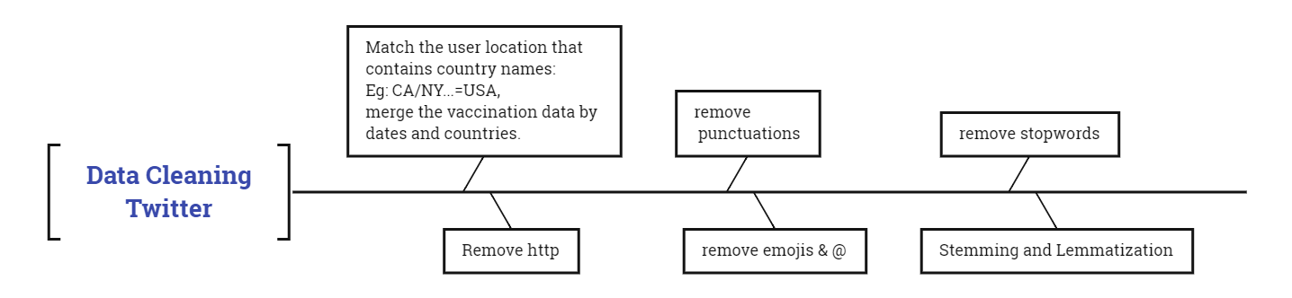
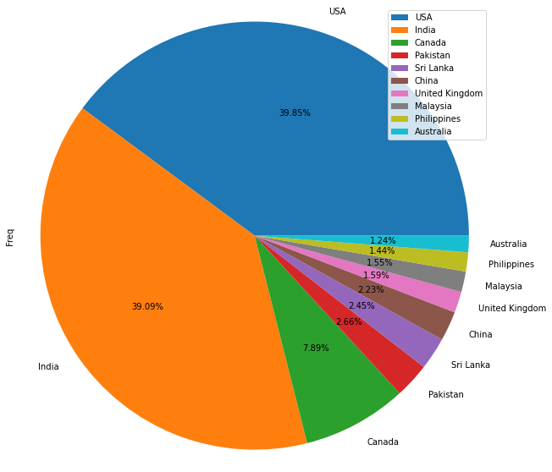
Data Cleaning
Dataset:
Kaggle
67834 obs.
Tweet Preprocessing
Sentiment Analysis
LDA Topic Modeling
Emotion Classification
Visual Data Exploration
Notes:
We found this dataset from Kaggle, the data originally comes from the Twitter API, which updates daily. However, our dataset includes 12 months of data starting from last December (2020).
After cleaning the text, the dataset only has 67834 observations. The pie chart shows the number of tweets from different countries posted on Twitter. In this plot, we only selected the top 10 countries. The users from USA and India obviously post more tweets than any other country.

Slide 5
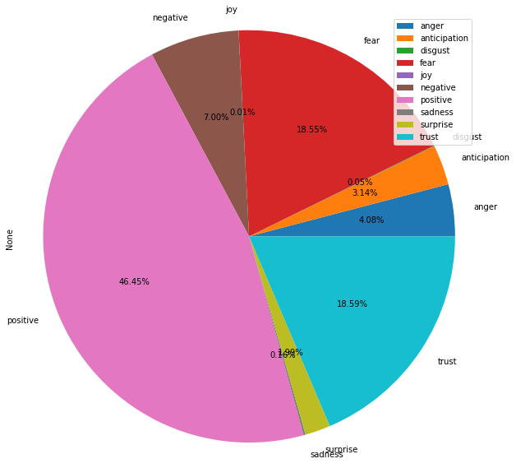
Sentiment Analysis -Emotions
National Research Council Canada (NRC) Emotion Lexicon
Tweet Preprocessing
Sentiment Analysis
LDA Topic Modeling
Emotion Classification
Visual Data Exploration
Notes:
We used NRC Lexicon to categorize our texts into different categories. And we selected the top emotions based on the text. According to the graph on the right, there is 46.45 percent of users are categorized as positive. There is 7% percent of posts on Twitter were categorized as negative. Fear and trust generally have the same proportion, which ranked 2 and 3 in all the categories. Additionally, I think the proportion of joy is very reasonable, during the covid-19 period, generally few people have joyful attitudes toward covid-19.

Slide 6
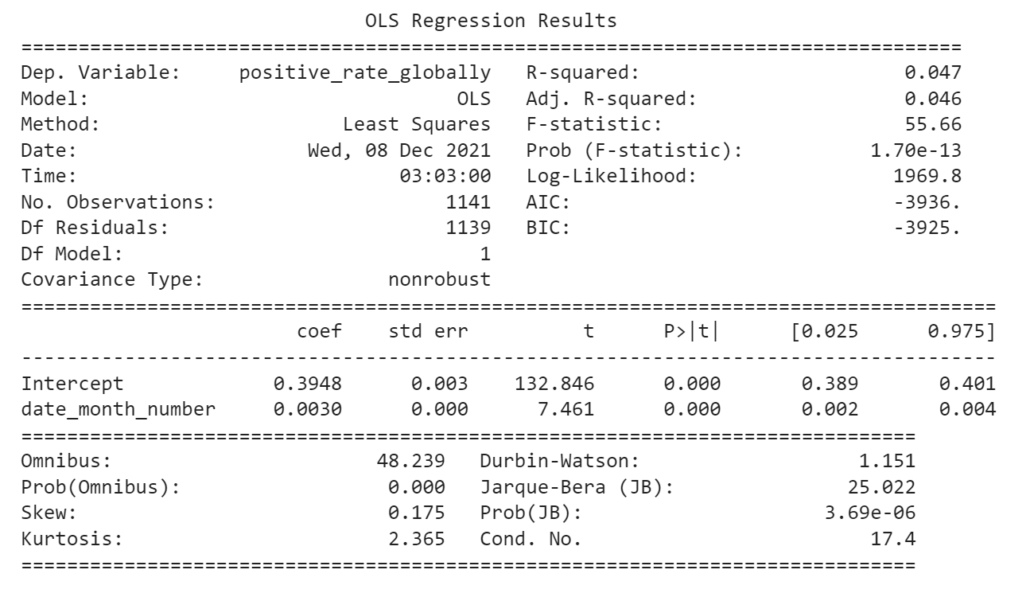
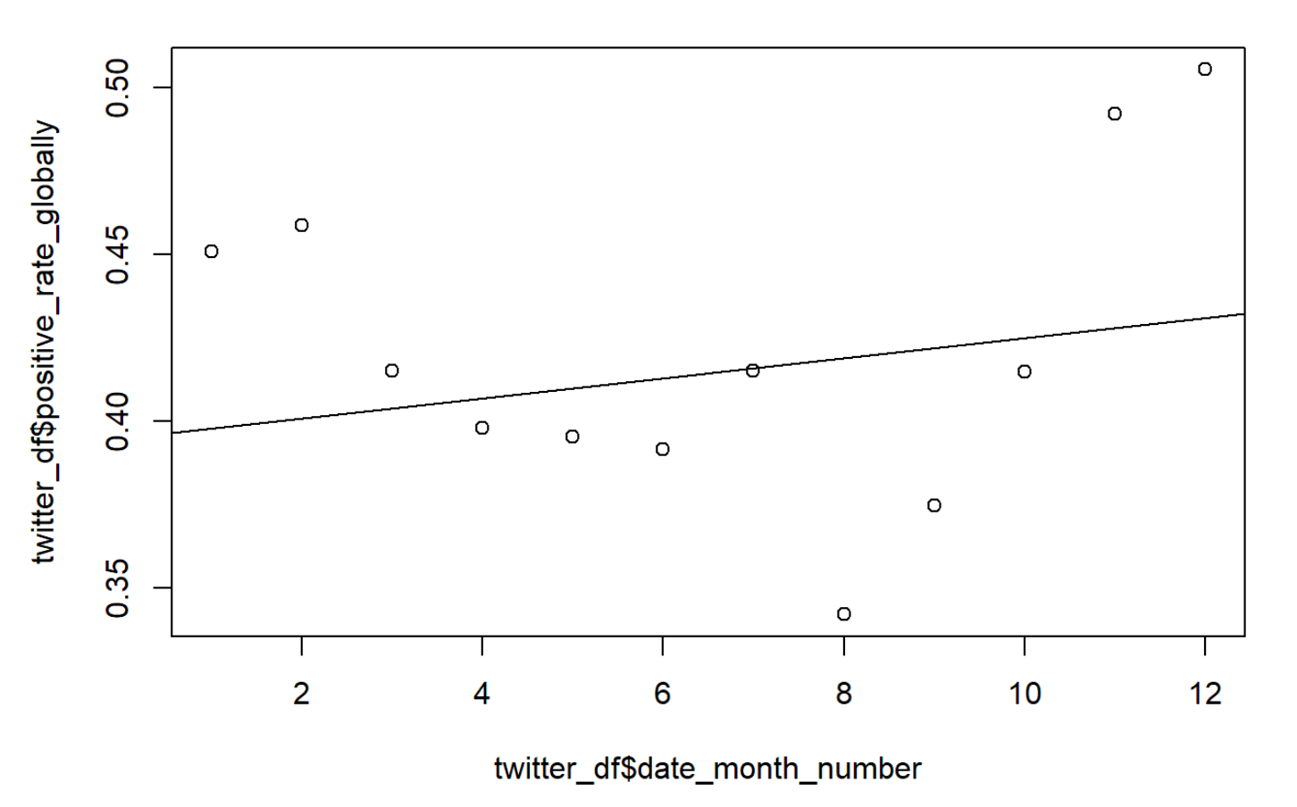
Sentiment Analysis-Vader Scores (Positive Attitude)
Tweet Preprocessing
Sentiment Analysis
LDA Topic Modeling
Emotion Classification
Visual Data Exploration
Notes:
We also generate scores from vader package for further sentiment analysis. Tweets with Vader Scores smaller than -0.05 are considered negative attitude. Scores between -0.05 and +0.05 refer to neutral attitude, and Vader Scores greater than 0.05 indicate positive attitude. Therefore, regarding each attitude, we divide the monthly numbers of tweets by the monthly total number of tweets for 12 months (starting from 12/2020 to 11/2021), and get the negative rate, neutral rate and positive rate respectively.
By conducting a bivariate OLS Model and regressing the positive rate on time of month, we can see there is a positive association between people’s positive attitudes towards COVID-19 vaccines and time. More specifically, for each unit increase in month, the global positive rate will increase by 0.003 percentage points. And it is significant at the 5% significance level. Therefore, we would reject the null hypothesis and conclude that people’s positive attitude towards COVID-19 vaccines is increasing as time goes by.

Slide 7
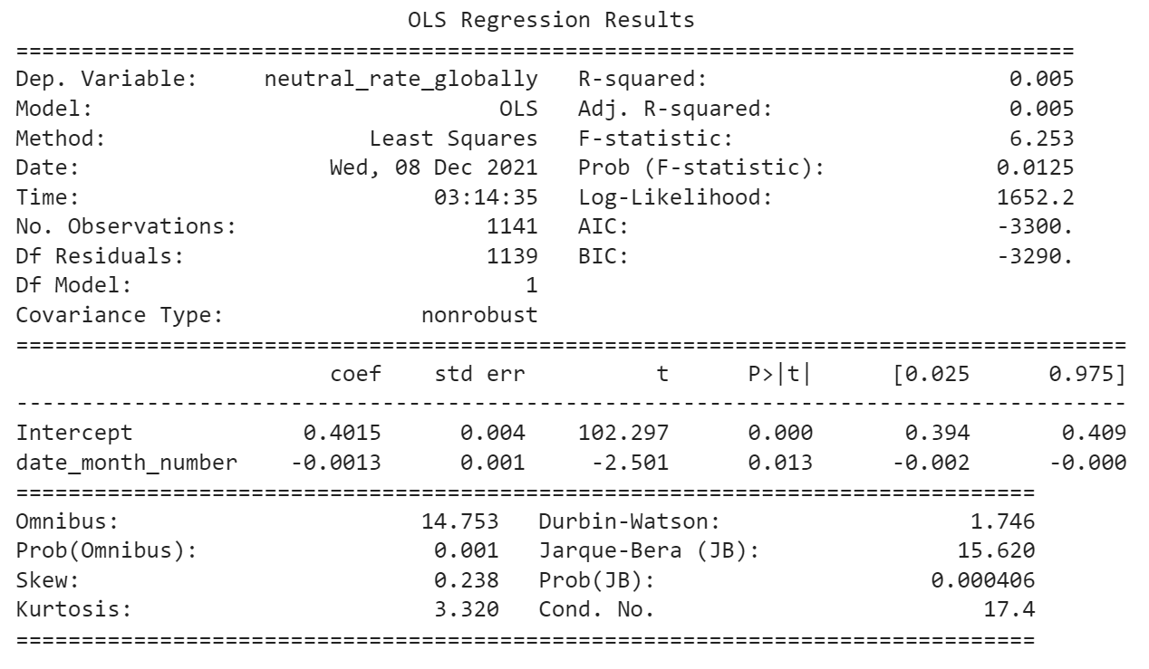
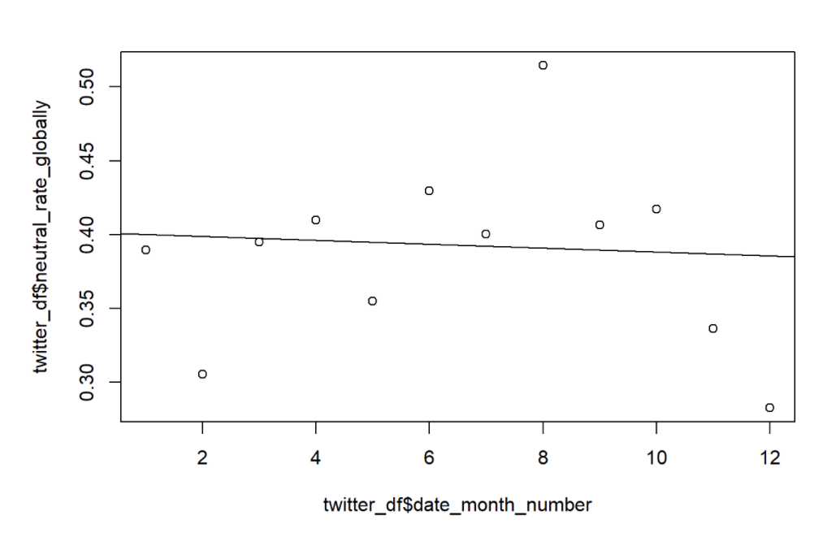
Sentiment Analysis-Vader Scores (Neutral Attitude)
Tweet Preprocessing
Sentiment Analysis
LDA Topic Modeling
Emotion Classification
Visual Data Exploration
Notes:
Similarly, by conducting an bivariate OLS Model and regressing the neutral rate on time of month, we can find a negative association between people’s neutral attitudes towards COVID-19 vaccines and time. For each unit increase in month, the global neutral rate will decrease by 0.0013 percentage points. And it is significant at the 5% significance level. Therefore, we would reject the null hypothesis and conclude that people’s neutral attitude towards COVID-19 vaccines is decreasing globally as time goes by.

Slide 8
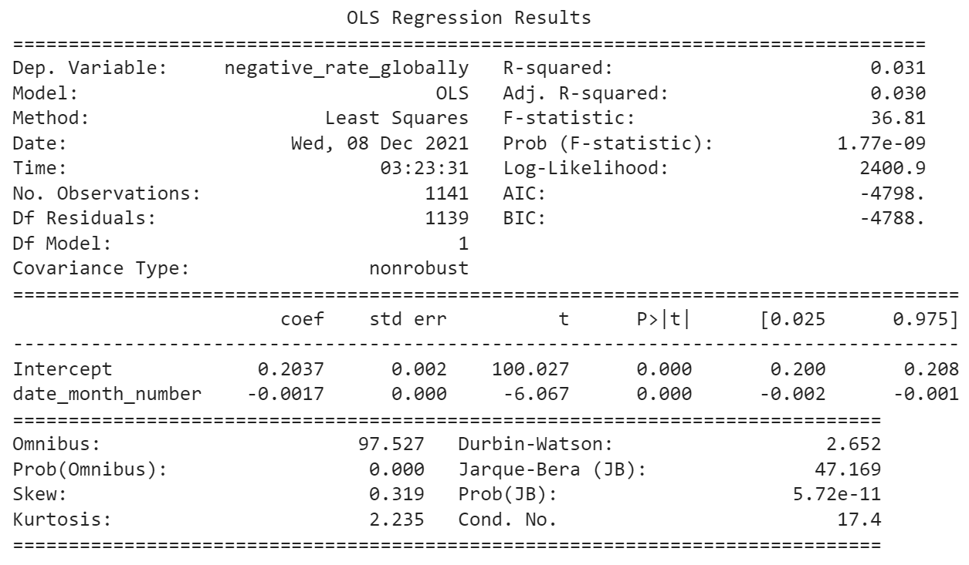
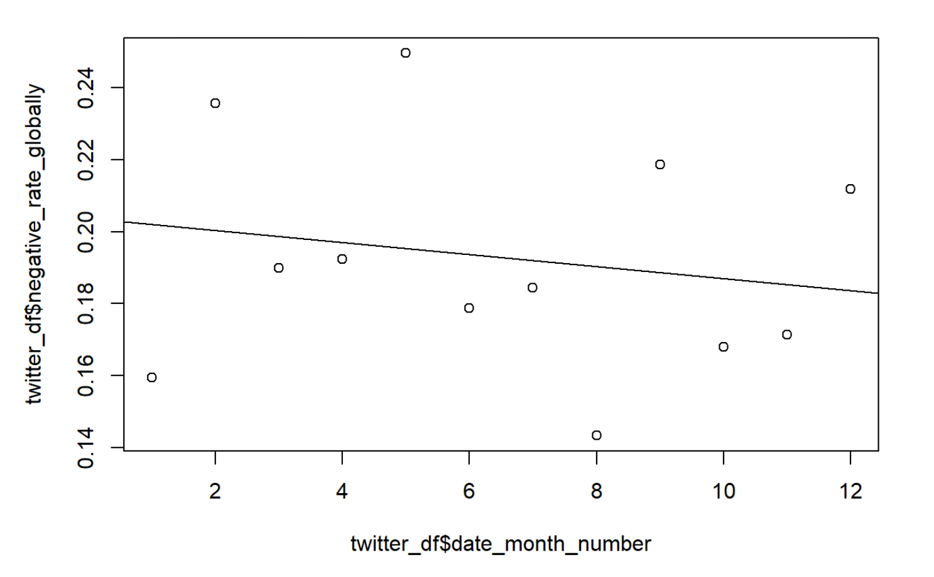
Sentiment Analysis-Vader Scores (Negative Attitude)
Tweet Preprocessing
Sentiment Analysis
LDA Topic Modeling
Emotion Classification
Visual Data Exploration
Notes:
We have also regressed the negative rate on time of month, and found a negative association between people’s negative attitudes towards COVID-19 vaccines and time. For each unit increase in month, the global negative rate will decrease by 0.0017 percentage points, which is also significant at the 5% significance level. Therefore, we would reject the null hypothesis and conclude that people’s negative attitude towards COVID-19 vaccines is decreasing globally as time goes by.

Slide 9
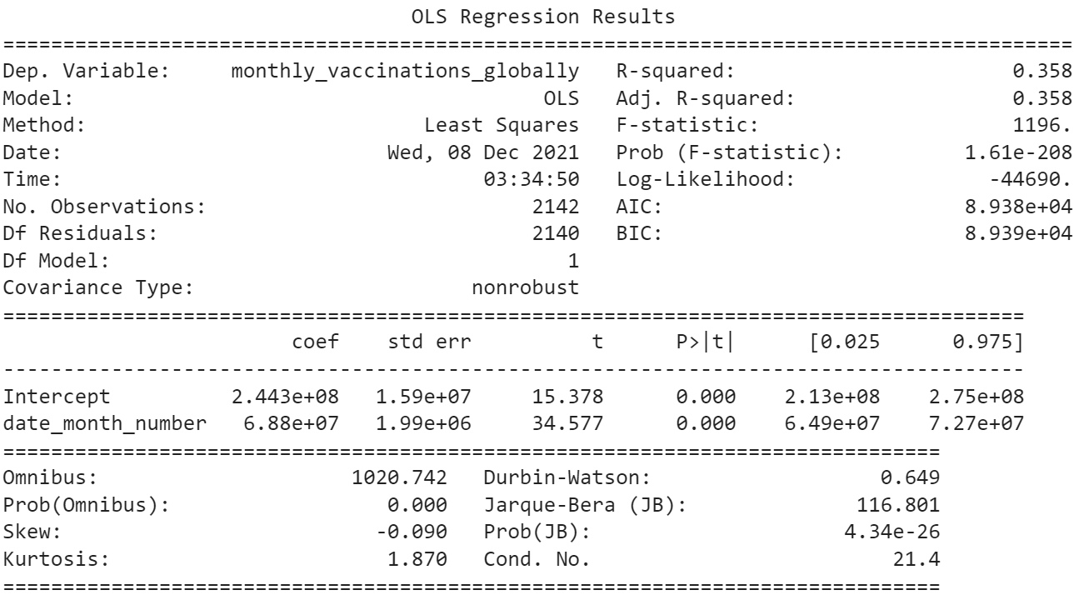
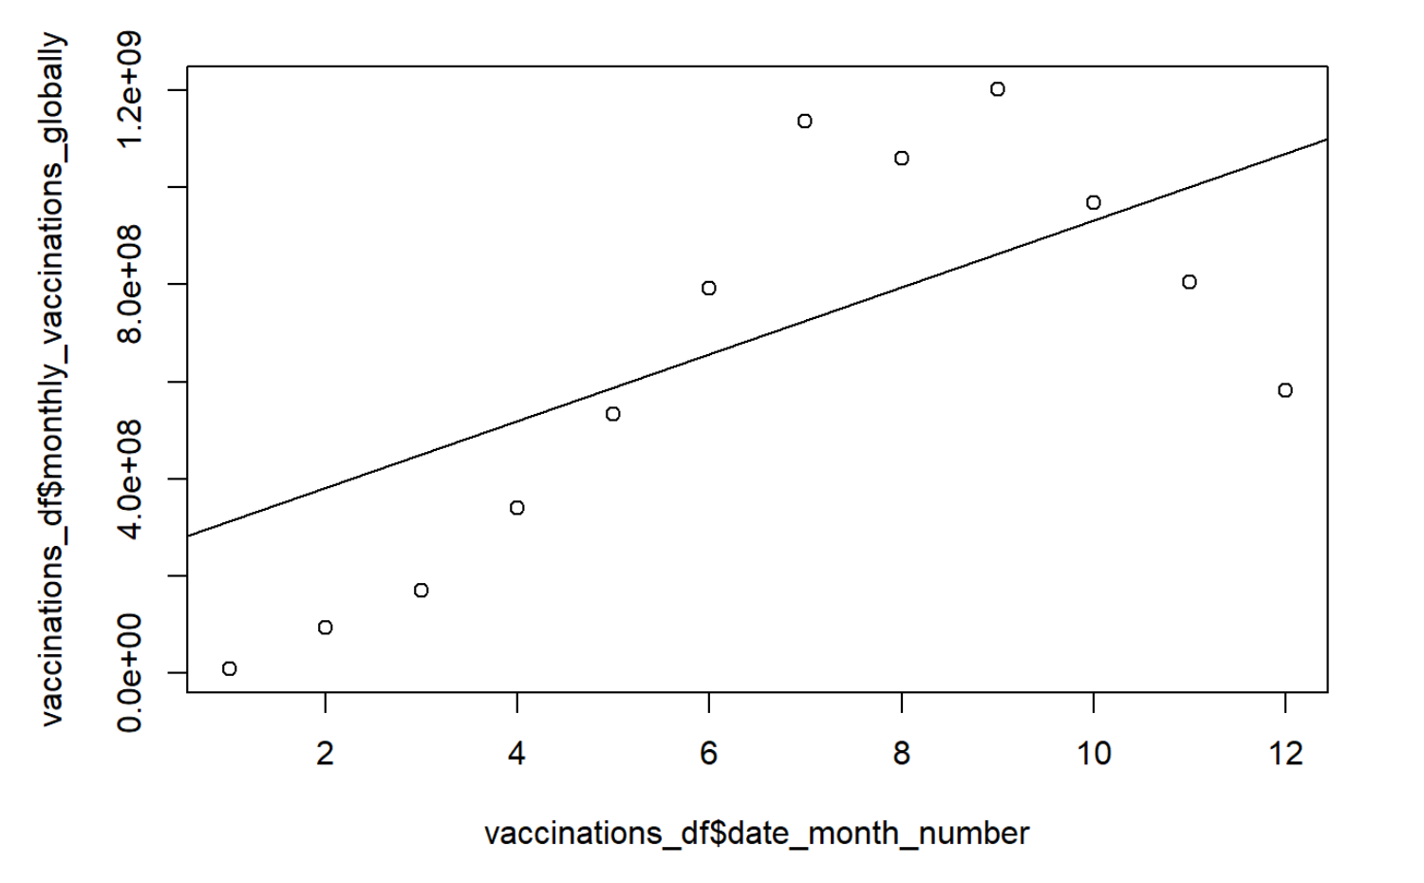
Sentiment Analysis-Vader Scores (Vaccinations)
Tweet Preprocessing
Sentiment Analysis
LDA Topic Modeling
Emotion Classification
Visual Data Exploration
Notes:
Finally, let’s take a look at the monthly vaccination trend across the world. We have aggregated the daily vaccination numbers to get the monthly vaccination data. From the OLS model, we have found a positive association. For each unit increase in month, the number of vaccinations administered per month will increase by 68.8 million doses. And it is significant at the 5% significance level. We can see that as people’s attitude towards COVID-19 vaccines is shifting from negative to positive, the monthly vaccinations are also increasing.

Slide 10
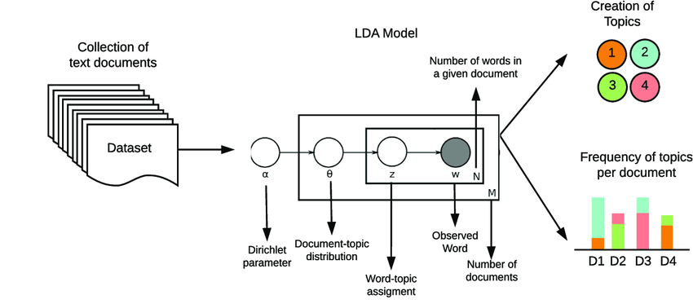
Topic Modeling of Sentiments with LDA
Goal: To identify commonly discussed topics in each sentiment category (positive, neutral and negative)
Tweet Preprocessing
Sentiment Analysis
LDA Topic
Modeling
Emotion Classification
Visual Data Exploration
Notes:
Pooja: While these sentiment scores give us a sense of twitter users general sentiments about COVID-19 vaccines, we were interested in understanding what topics were commonly discussed among tweets labeled positive, neutral and negative.
We performed LDA which as we know is a form of topic modelling that uses the frequency with which grounds of words appear together across documents to identify clusters.

Slide 11
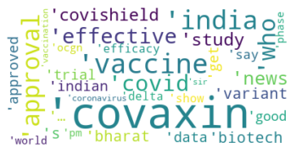
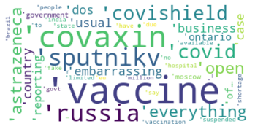
Topic Modeling with LDA
Positive Topics
Negative Topics
Tweet Preprocessing
Sentiment Analysis
LDA Topic
Modeling
Emotion Classification
Visual Data Exploration
Notes:
Pooja: And here we can see differences in term frequency between the topics represented in positive tweets, about approvals, effectiveness, approvals versus those in negative tweets: ‘embarrassing’, ‘government’, ‘hospital’.
Positive_topics:
However, there are several different emotions that could fall under positive and negative topics, and so we decided to do a deeper classification of emotions

Slide 12
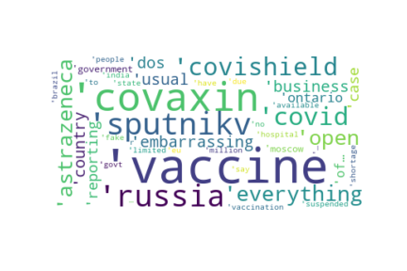
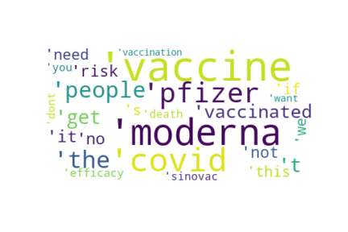
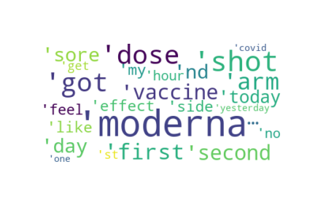
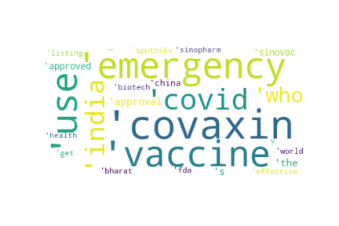
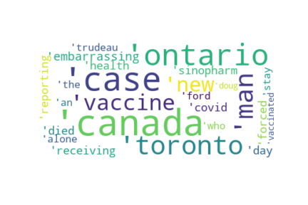
Vaccine Efficacy
Overall
Vaccination and Side Effects
Emergency COVID Response
Canadian Health Response

Slide 13
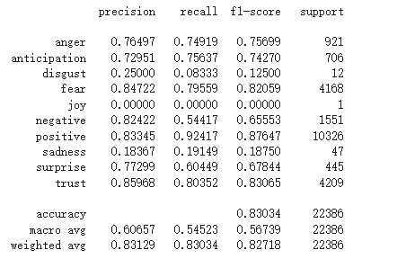
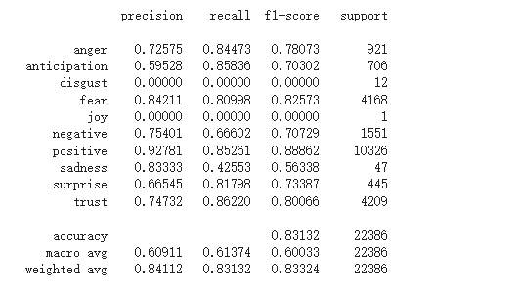
Classification -Emotions(LightGBM)
Roc Auc Score:
Roc Auc Score:
Tweet Preprocessing
Sentiment Analysis
LDA Topic
Modeling
Emotion Classification
Visual Data Exploration
Notes:
We performed emotion classification using Lightgbm with tf idf. So far, we get 83% accuracy without tuning. The classification report on the left shows the precision, recall, f1-score, and the number of observations for each emotion. However, as you can see our data is highly imbalanced, since positive, trust, fear is dominant. To avoid the bias of data imbalance, we tried to use smote oversampling, as you could see from the right classification report, we did have a little improvement in accuracy and a huge improvement using roc AUC score.

Slide 14
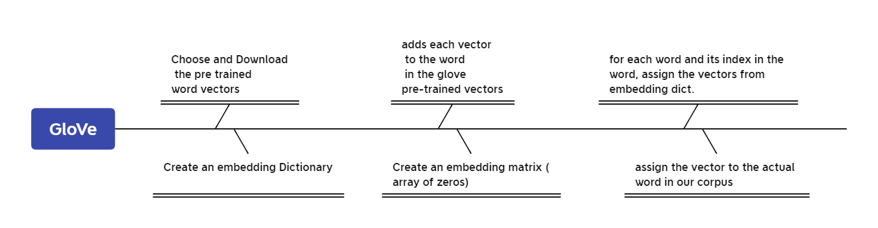
Classification - Word Embedding(GloVe)
tf(t,d) = count of t in d / number of words in d
idf(t) = log(N/(df + 1))
GloVe: Global Vectors for word Representation
Tweet Preprocessing
Sentiment Analysis
LDA Topic
Modeling
Emotion Classification
Visual Data Exploration
Notes:
We all know how Tf Idf works, however, as the basic formula shows above, the tf idf obviously is unable to capture the semantic meaning of the text. It considers the importance of the words due to how it weighs them, but it cannot necessarily derive the contexts of the words and understand importance that way. Therefore, I used another way to do the word embedding work for text. It’s called Glove, GloVe is an unsupervised learning algorithm for obtaining vector representations for words. Training is performed on aggregated global word-word co-occurrence statistics from a corpus, and the resulting representations showcase interesting linear substructures of the word vector space. In short, the basic idea behind the GloVe word embedding is to derive the relationship between the words from statistics. To avoid the complex mathematics theories, Here is a flow chart that how we use glove in python. We chose the 200 dimensions pre trained word vectors in our project.

Slide 15
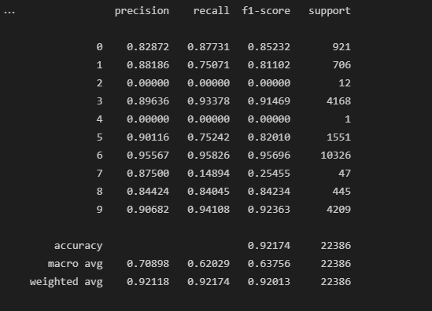
Classification -Emotions(LSTM)
LSTM + Glove
{'anger': 0,
'anticipation': 1,
'disgust': 2,
'fear': 3,
'joy': 4,
'negative': 5,
'positive': 6,
'sadness': 7,
'surprise': 8,
'trust': 9}
Tweet Preprocessing
Sentiment Analysis
LDA Topic
Modeling
Emotion Classification
Visual Data Exploration
Notes:
We also tried the LSTM model for emotion detection with three layers,, however, since the limitation of the time, I did not tune the batch size, epochs, learning rate, etc.Because my gpu takes 15 mins to run one epoch. However, the lstm model works great compared to the lightgbm. It has a better f1 score for each categories and the overall accuracy compared to the previous models.

Slide 16
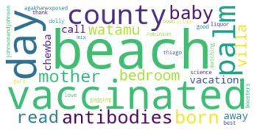
Visual Exploration
Word Cloud
Removed some words:
Tweet Preprocessing
Sentiment Analysis
LDA Topic
Modeling
Emotion Classification
Visual Data Exploration
Notes:
After we have 10 categorized emotions, I did a wordcloud like this for each of the 10 emotions. I noticed that there are some words that are most common in every word cloud, so I removed those words, including covid, vaccine, the combinations of those two words, and the main brand of the vaccines, so that we can get a better idea of what people are really saying on twitter.

Slide 17
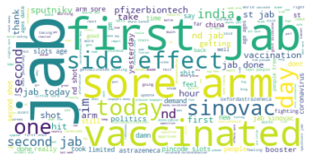
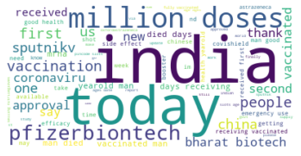
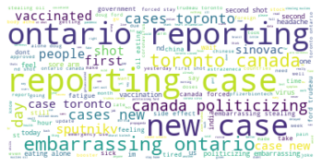
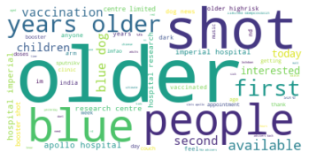
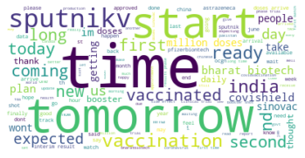
Word Cloud - a few example
anger
positive
negative
joy
sadness
anticipation
Notes:
Now let’s look at a few examples that I think are particularly interesting. The first one is the word cloud for anger. We can see that people whose tweets are categorized as anger use the word “jab” a lot, instead of vaccination or shot. The second one is positive, it includes words like today, approval, and people seem to be pretty positive about india. The third one is negative, we can see that it has a lot of words related to canada, such as ontario, case toronto, canada politicizing. I search on google and found out it was because one time Canada government planned to produce their own vaccines with a chinese pharmacy company funded by the chinese government, and it caused a lot of disapproval and fear among canadian people. Then we have joy, with joyful words like beach, palm, baby, and thank. The next two word clouds for sadness and anticipation also have words that clearly corresponds to their categories.

Slide 18
Q&A

Slide 19
Thanks for listening!

